Slide 1
Experimental Design For Engineers
ISYE435-535

Slide 2
The Blocking Principle
Blocking is a technique for dealing with nuisance factors.
A nuisance factor is a factor that probably has some effect on the response, but it’s of no interest to the experimenter…however, the variability it transmits to the response needs to be minimized.

Slide 3
The Blocking Principle
Typical nuisance factors include batches of raw material, operators, pieces of test equipment, time (shifts, days, etc.), different experimental units.
Many industrial experiments involve blocking (or should)

Slide 4

The Blocking Principle
Failure to block is a common flaw in designing an experiment (consequences?)

Slide 5
The Blocking Principle
If the nuisance variable is known and controllable, we use blocking

Slide 6
The Blocking Principle
If the nuisance factor is known and uncontrollable, sometimes we can use the analysis of covariance to remove the effect of the nuisance factor from the analysis.
If the nuisance factor is unknown and uncontrollable (a “lurking” variable), we hope that randomization balances out its impact across the experiment.

Slide 7
The Hardness Testing Example
Determine whether 4 different tips produce different (mean) hardness reading on a Rockwell hardness tester
Assignment of the tips to an experimental unit; that is, a test coupon.
Structure of a completely randomized experiment
The test coupons are a source of nuisance variability
Alternatively, the experimenter may want to test the tips across coupons of various hardness levels
The need for blocking

Slide 8
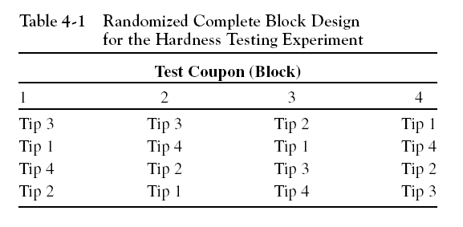
The Hardness Testing Example
Suppose that we use b = 4 blocks:
Notice the two-way structure of the experiment
Once again, we are interested in testing the equality of treatment means, but now we have to remove the variability associated with the nuisance factor (the blocks)

Slide 9
Extension of the ANOVA to the RCBD
Suppose that there are a treatments (factor levels) and b blocks
A statistical model (effects model) for the RCBD is
The relevant (fixed effects) hypotheses are

Slide 10
Extension of the ANOVA to the RCBD
ANOVA partitioning of total variability:

Slide 11
Extension of the ANOVA to the RCBD
The degrees of freedom for the sums of squares in
are as follows:
Therefore, ratios of sums of squares to their degrees of freedom result in mean squares and the ratio of the mean square for treatments to the error mean square is an F statistic that can be used to test the hypothesis of equal treatment means

Slide 12
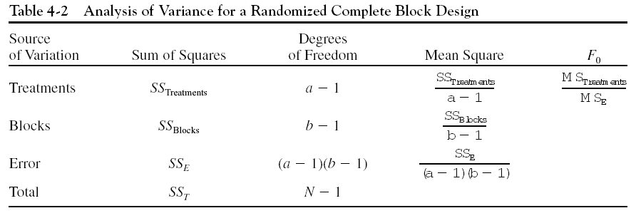
ANOVA Display for the RCBD

Slide 13
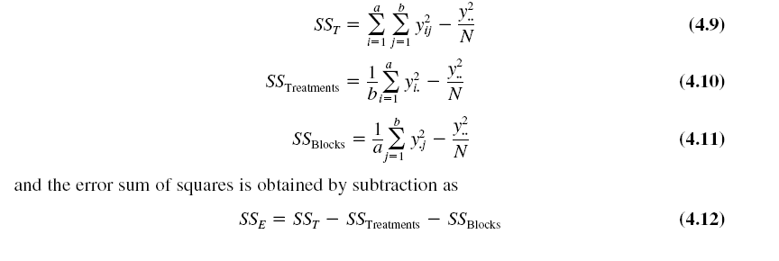
Manual computing (ugh!)…
Design-Expert analyzes the RCBD

Slide 14
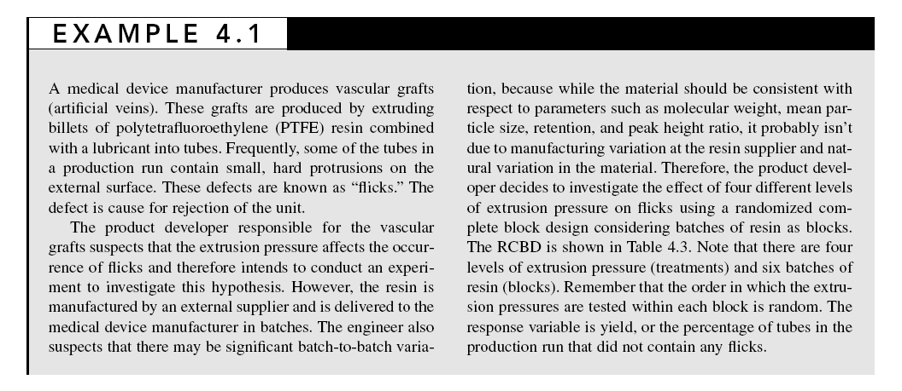

Slide 15
Vascular Graft Example (pg. 141)
To conduct this experiment as a RCBD, assign all 4 pressures to each of the 6 batches of resin
Each batch of resin is called a “block”; that is, it’s a more homogenous experimental unit on which to test the extrusion pressures

Slide 17
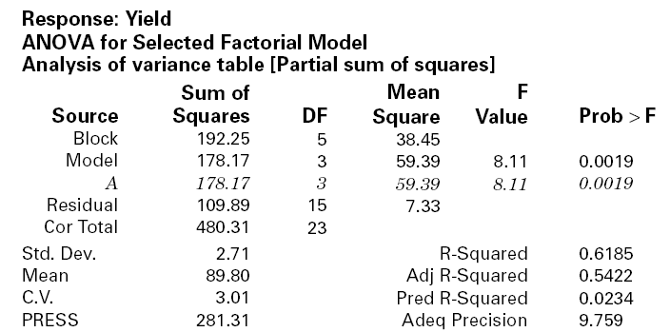
Vascular Graft Example
Design-Expert Output

Slide 18
Residual Analysis for the
Vascular Graft Example

Slide 19
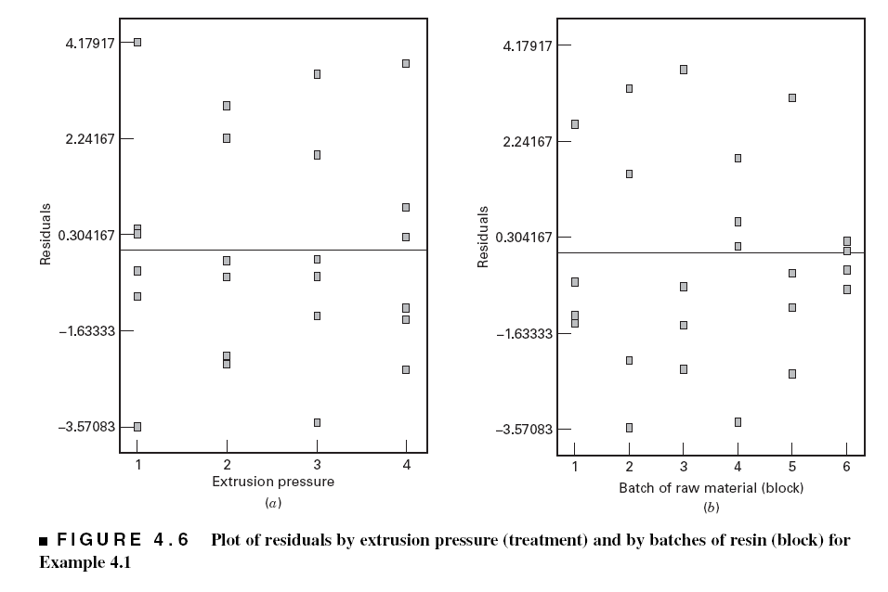
Residual Analysis for the
Vascular Graft Example

Slide 20
Residual Analysis for the
Vascular Graft Example
Basic residual plots indicate that normality, constant variance assumptions are satisfied
No obvious problems with randomization
No patterns in the residuals vs. block
Can also plot residuals versus the pressure (residuals by factor)
These plots provide more information about the constant variance assumption, possible outliers

Slide 21
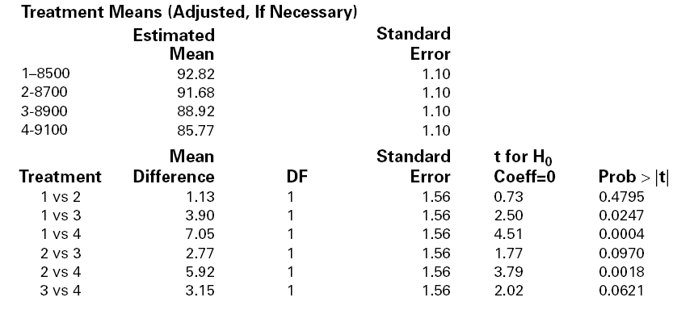
Multiple Comparisons for the Vascular Graft Example – Which Pressure is Different?
Also see Figure 4.3, Pg. 144

